Slide 1
WhatsApp Automation Using RPA
Presented By:
Kartik Garg
Kartavya Verma

Slide 2
What is WhatsApp Automation ?
Using the Robotic Process Automation we can automate our WhatsApp for sending a same message to the number of users or send a personalised message to the respective contacts in a single go.
It reduces the human intervention by almost 80%.
This saves lots of your time

Slide 3
Features of WhatsApp Automation
Using this you can specify the contacts and the messages you want to send in a excel file.
All the messages will be sent automatically.
Same message can be sent to number of contacts simultaneously.
Personalised messages can also be sent to the respective specified contacts.
It also tells if the message is successfully delivered or not in case of any error it’s a very beneficial feature.

Slide 4
How it works ?
The RPA tool will read all the information from the excel file specified by the user. Based on that it will search the contacts in the WhatsApp web and then send the required messages.
Though initially the login to the WhatsApp Web have to be done/ performed manually.
After sending messages successfully to the specified contacts it will make a entry in the excel file in the status column with the string successfully sent or the error message.
Using the above feature one can get the list the of people to whom message could not be sent.

Slide 5
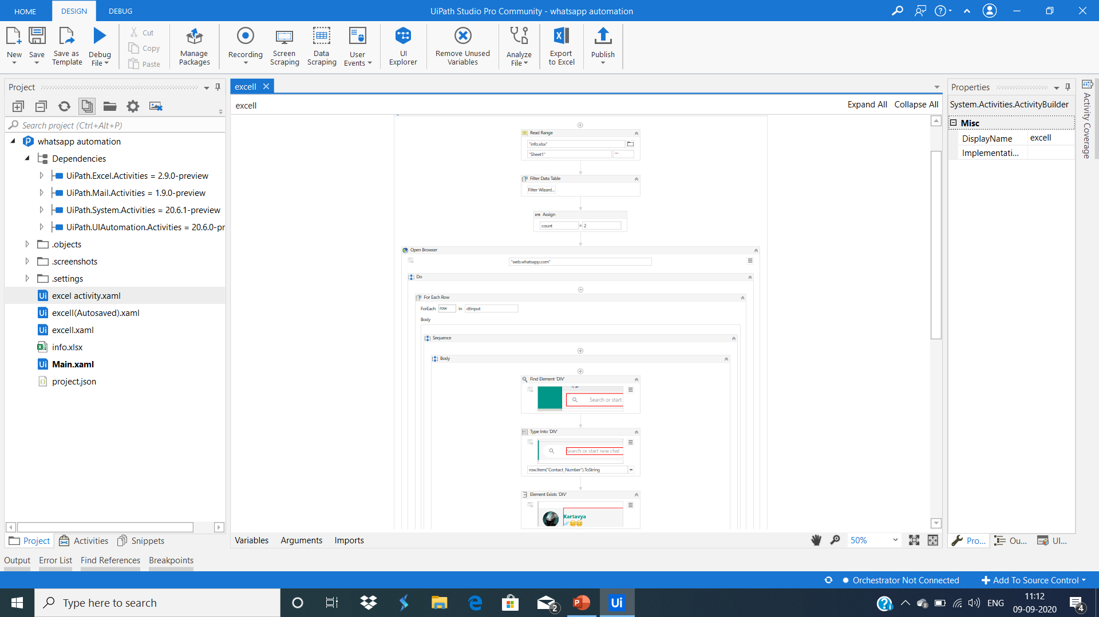
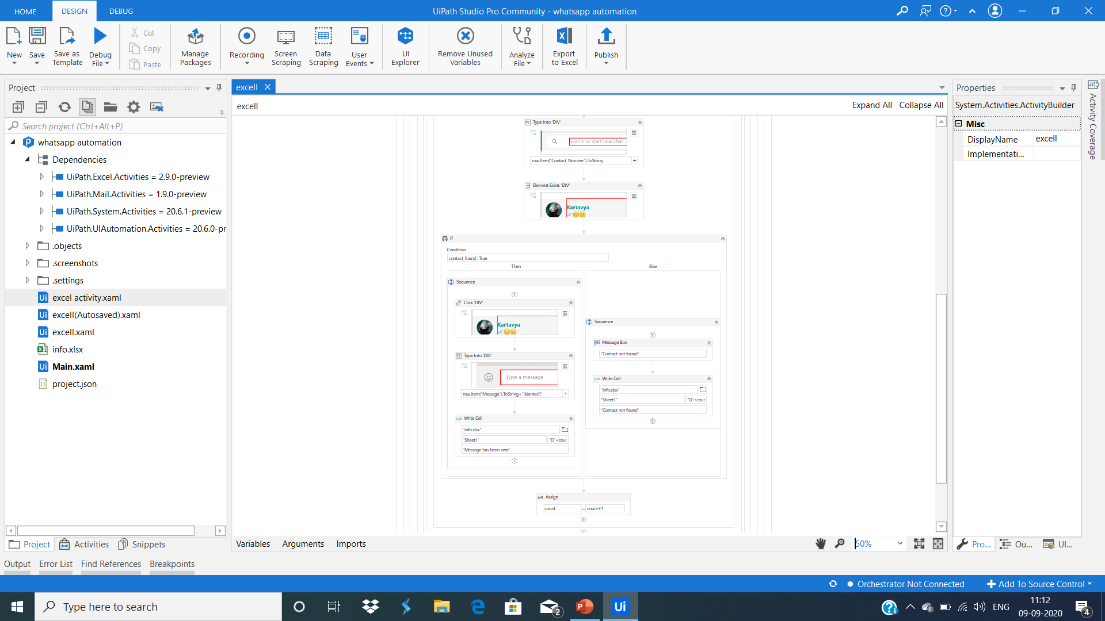
Some Program Glimpses

